Slide 1
EGit in CCS 5.1.0

Slide 2
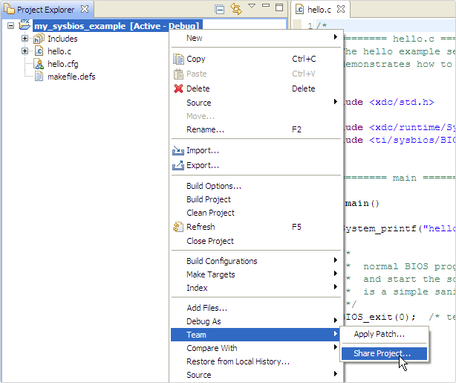
How to begin
Right click on project
Team -> Share Project

Slide 3
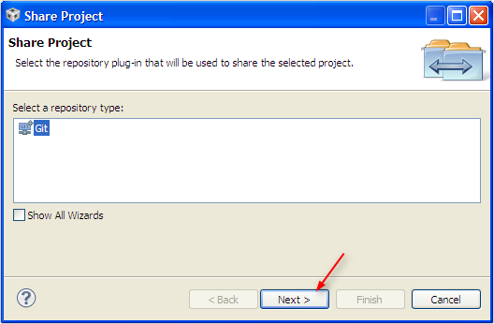

Slide 4
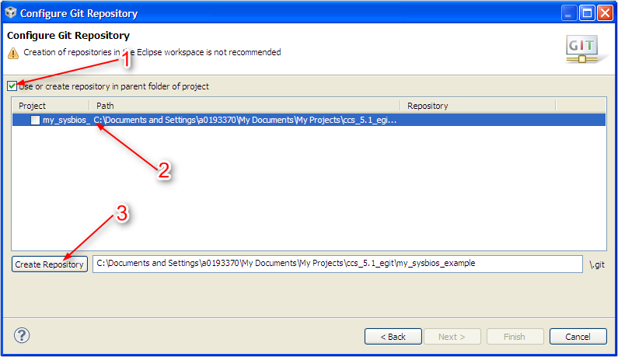

Slide 5
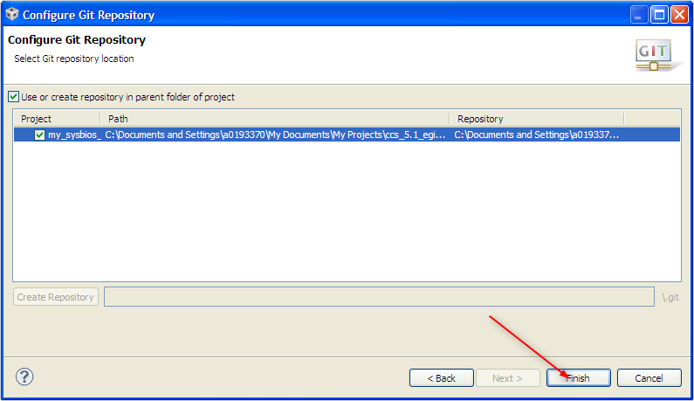

Slide 6
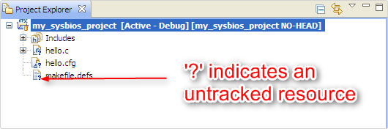
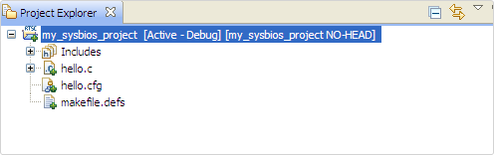
Choose which files will be tracked
Right click on Project and select Team -> Add. This will track everything in the project directory.
‘+’ indicates a file is staged, i.e. ready to be committed

Slide 7
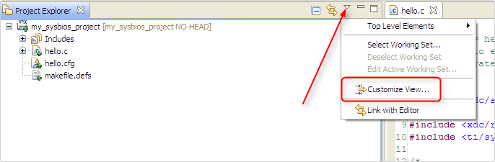
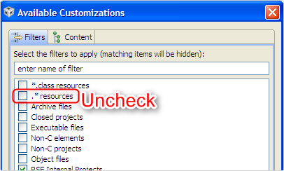
Choose which files will be ignored
We need to see all the files in the directory.

Slide 8
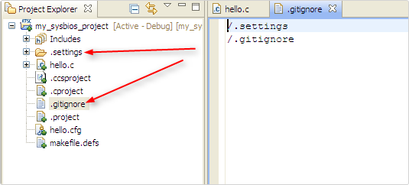
Ignore .settings, Debug, Release, etc.
Right click on a file/folder such as .settings and select Team -> Untrack since we previously added everything and then Team -> Ignore so it doesn’t show up as unknown in commit dialogs.
Folder will no longer show an icon to indicate it’s tracked/staged.
Can go back to Customize View and hide the *.resources again now that we’ve “ignored” the unneeded files

Slide 9
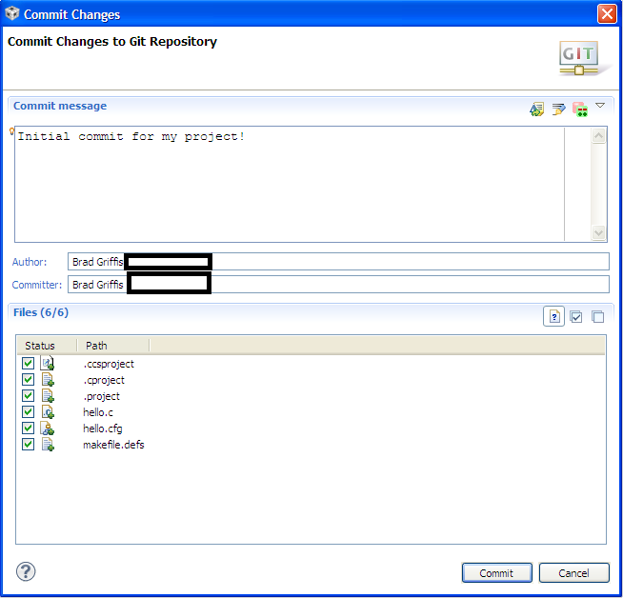
First Commit
Right-click project, Team -> Commit

Slide 10
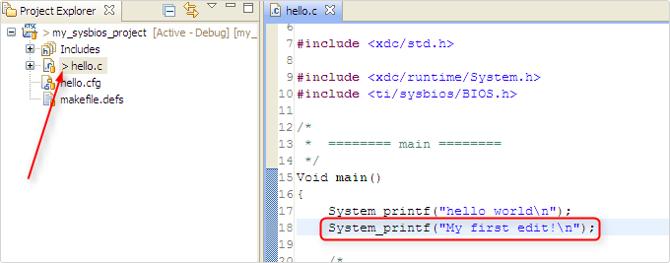
Future edits/commits (1 of 2)
When a file has been saved with new changes, but not yet committed it will be marked with a ‘>’
Note that the project also shows a ‘>’ since files under it have not been committed. This is helpful for very large projects.

Slide 11
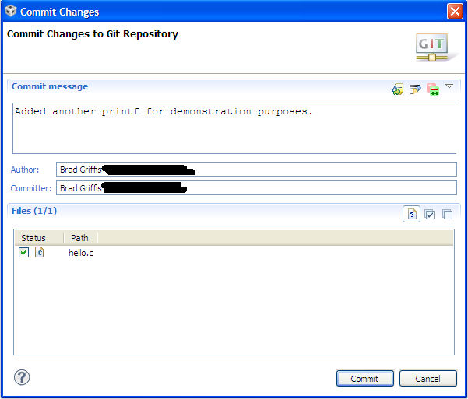
Future edits/commits (2 of 2)
Team -> Commit will now prompt to you commit a change for whatever files were modified

Slide 12
Other common commands
Team -> Switch to -> branch-name
Team -> Switch to -> New Branch
Team -> Show in Repositories View
High level view of what branches, etc. are available
Team -> Show in History
See specific commit logs, diffs, etc.
Compare with -> Commit
See a graphical diff of precisely what’s changed between two commits

